Slide 1
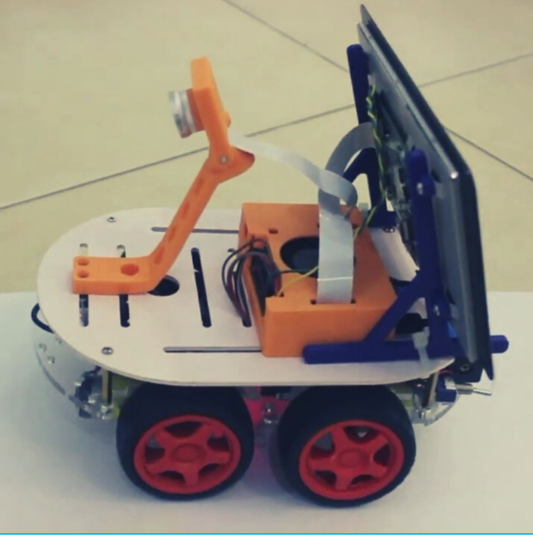
Self Driving Simulation using Nvidia’s Simulator

Slide 2
Introduction
In this project, we implement a convolutional neural network (CNN) to map raw pixels from the captured images to the steering commands for a self-driving car. With minimum training data from the humans, the system learns to steer on the road, with or without the lane markings. This report is organized as follows. Section II contains a brief overview of the relevant works developed in the past years. Section III and IV elaborate on the data collection and data preprocessing part of the project respectively.
. In recent years, autonomous driving algorithms using low-cost vehicle-mounted cameras have attracted increasing research endeavours from both, academia and industry. Various levels of automation have been defined in autonomous driving. There’s no automation in level 0. A human driver controls the vehicle. Level 1 and 2 are advanced driver assistance systems where a human driver still controls the system but a few features like brake, stability control, etc. are automated. Level 3 vehicles are autonomous, however, a human driver is still needed to monitor and intervene whenever necessary.
.

Slide 3
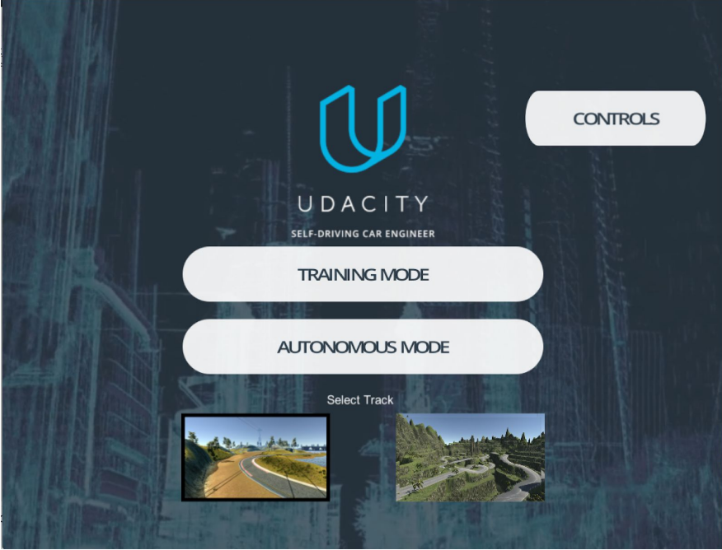
Data Collection
We used Udacity’s self-driving car simulator for collecting the data. This simulator is built in Unity and was used by Udacity for the Self-Driving Nanodegree program but was recently open-sourced [6]. It replicates what NVIDIA did in the simulation. We can collected all our data from the simulator. Using our keyboard to drive the car, we were able to instruct the simulated vehicle to turn left, right, speed up and slow down. Another important aspect is that this simulator can be used for training as well as testing the model. Hence, it has two modes: (i) Training mode, and (ii) Autonomous mode as shown in Fig. 1

Slide 4
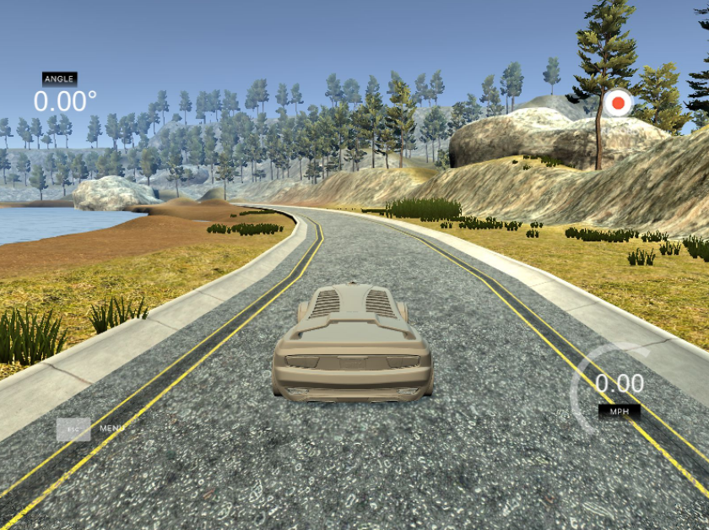
.
The training mode is used to collect the data and the autonomous mode is used to test the model. Additionally, there are two types of tracks in the simulator - the lake track and the jungle track. The lake track is relatively smaller and easy to handle the car when compared with the jungle track as shown in Fig. 2 and Fig. 3. The simulator captures data when the car is driven around the track using left and right keys to control the steering angles and up and down arrows to control the speed.
From this, the simulator generates a folder containing images and one CSV file. The image folder contains three images for every frame captured by the left, center and right camera and every row in the CSV file contains four metrics - steering angle, speed, throttle and brake, for every captured frame. Fig. 4, Fig. 5. and Fig. 6 show the left, center and right image, for one frame.

Slide 5
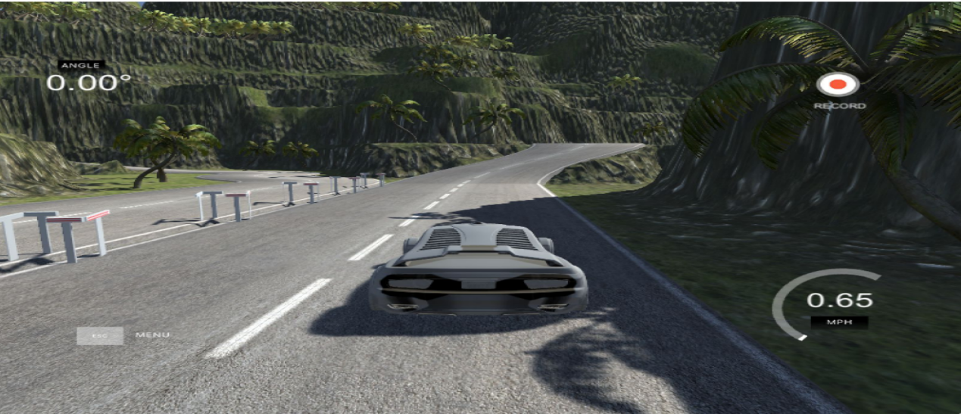
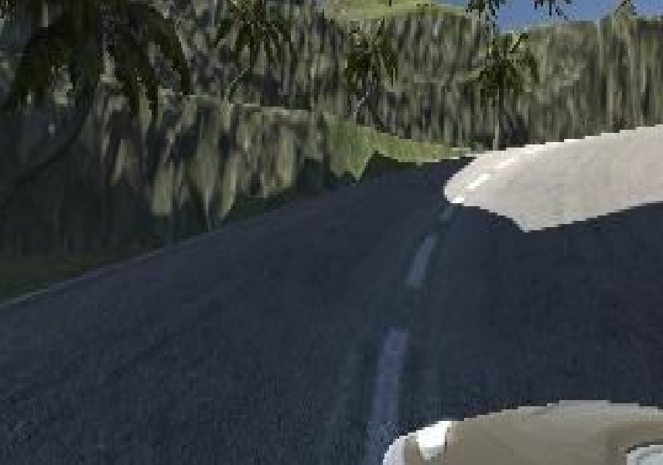
.
.

Slide 6
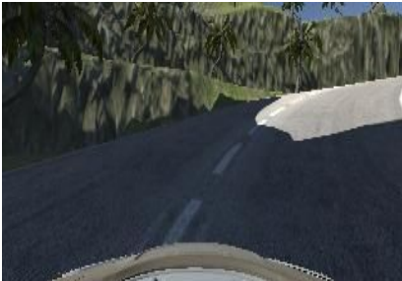
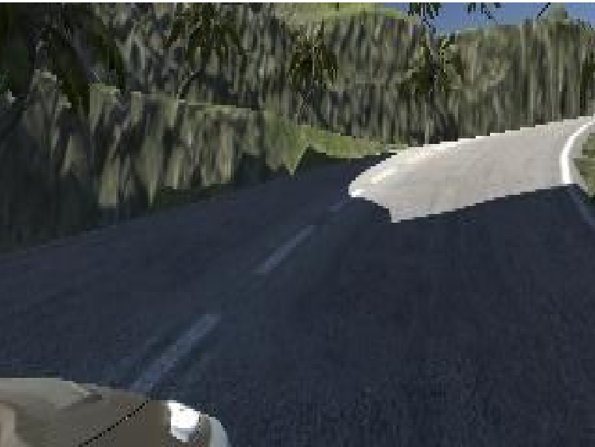
.
.

Slide 7
.
DEEP LEARNING MODEL
The deep learning model we prepared is based on the research done by NVIDIA for their autonomous vehicle . The model comprises of the following important layers.
A) Convolutional Layer
Convolutional layer applies the convolution function (filter) on the input image and produces a 3D output activation of neurons. This layer helps to find various features of the image which is used for classification. The number of convolutional layers in the network depends on the type of application. The initial convolutional layers in the networks help detect the low level features of the image which are simple and the convolutional layers further help in detecting the high-level features of the image.

Slide 8
.
B) Max Pooling Layer
Pooling/Down sampling layer helps in reducing the number of parameters/weights in the network and helps in reducing the training time without losing any specific feature information of the image. This layer produces a smaller image than the input image by downsampling the image using pooling of neurons. There are different types of pooling like max pooling, average pooling, L2-norm pooling etc but max pooling is the one which is most widely used.

Slide 9
.
C)Dense Layer
Dense layer or Fully connected layer is the same as normal neural network layer in which all the neurons in this layer are connected to each neurons from previous layer. This layer is generally designed as the final layer in the convolutional The entire architecture diagram is shown in There are 5 convolutional layers with varying number of filters and sizes and a dropout after that to handle overfitting.

Slide 10

.
PERFORMANCE EVALUATION
For performance evaluation during training, mean squared error was used as a loss function to keep a track of the performance of the model.
MSE = (1/n) ∑(y y ) n i=1 − ′ 2

Slide 11
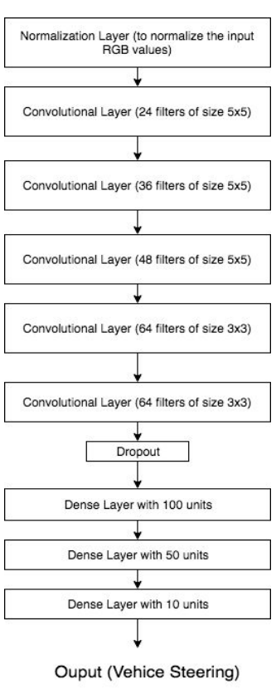
Deep Network Architecture
.

Slide 12
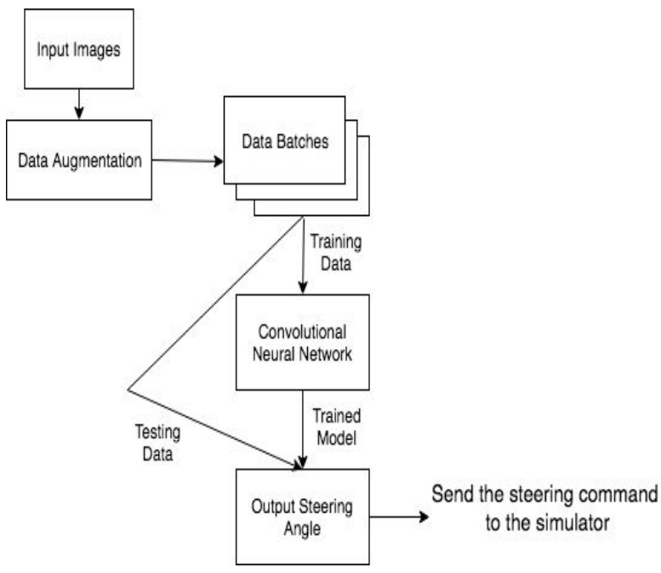
High Level System Architecture

Slide 13
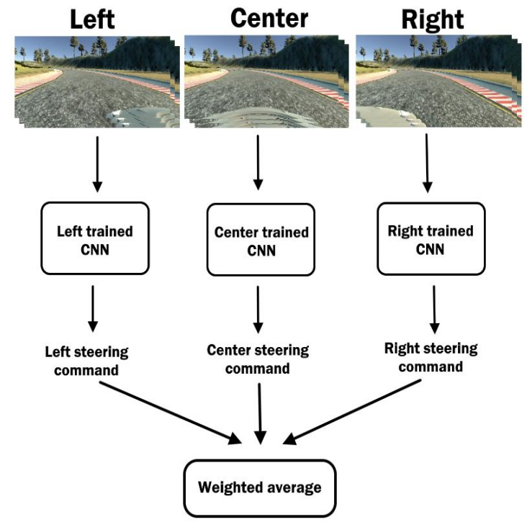
Model Prediction
.
.
.

Slide 14
EXPERIMENTAL SETUP The machine configuration for our experiments was as follows: HARDWARE: ● RAM - 16 GB ● Operating System - OS X - 10.13.3 ● Hard disk size - 1 TB SOFTWARE: ● Python ● Unity 3D ● Keras (Tensorflow Backend) ● Anaconda ● Open CV

Slide 15
Thanks!
.

